Slide 1
Credit Card Users Churn Prediction-Business Presentation
Sandhya Nair
March 2021

Slide 2
Objective
Explore and visualize the dataset.
Build a classification model to predict if the customer is going to churn or not
Optimize the model using appropriate techniques
Generate a set of insights and recommendations that will help the bank

Slide 3
Data Dictionary
CLIENTNUM: Client number. Unique identifier for the customer holding the account
Attrition_Flag: Internal event (customer activity) variable - if the account is closed then 1 else 0
Customer_Age: Age in Years
Gender: Gender of the account holder
Dependent_count: Number of dependents
Education_Level: Educational Qualification of the account holder
Marital_Status: Marital Status of the account holder
Income_Category: Annual Income Category of the account holder
Card_Category: Type of Card
Months_on_book: Period of relationship with the bank
Total_Relationship_Count: Total no. of products held by the customer
Months_Inactive_12_mon: No. of months inactive in the last 12 months
Contacts_Count_12_mon: No. of Contacts in the last 12 months

Slide 4
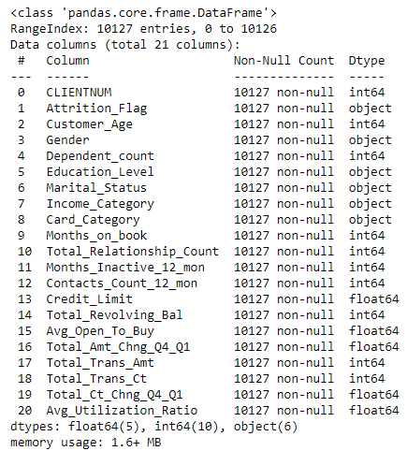
Data Dictionary & Data Information
Credit_Limit: Credit Limit on the Credit Card
Total_Revolving_Bal: Total Revolving Balance on the Credit Card
Avg_Open_To_Buy: Open to Buy Credit Line (Average of last 12 months)
Total_Amt_Chng_Q4_Q1: Change in Transaction Amount (Q4 over Q1)
Total_Trans_Amt: Total Transaction Amount (Last 12 months)
Total_Trans_Ct: Total Transaction Count (Last 12 months)
Total_Ct_Chng_Q4_Q1: Change in Transaction Count (Q4 over Q1)
Avg_Utilization_Ratio: Average Card Utilization Ratio
Data Information:
There are 10127 rows and 21 columns.
We don't see any missing values in the columns
There are 10 int variables,5 float variables and 6 object variables

Slide 5
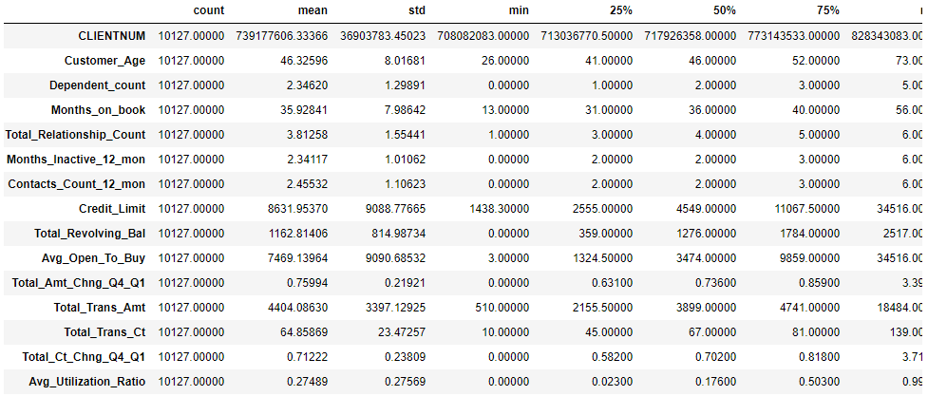
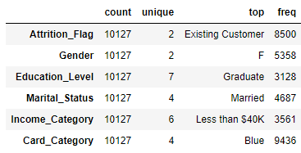
Data Information
Age of customers range from 26 to 73
Customers have min 13 years of relationship
with the Bank
The max number of products held is 6
Credit limit ranges from 1438 to 34516
Avg_open_to_buy has a huge range from
amount 3 to 34516
Most of the customers are existing customers
who has not attrited yet
Most of the customers are Female ,have graduation
and are married
Most of the customers make less than 40K income
The card category that most customers hold is Blue.
Attrition_Flag is our target variable

Slide 6
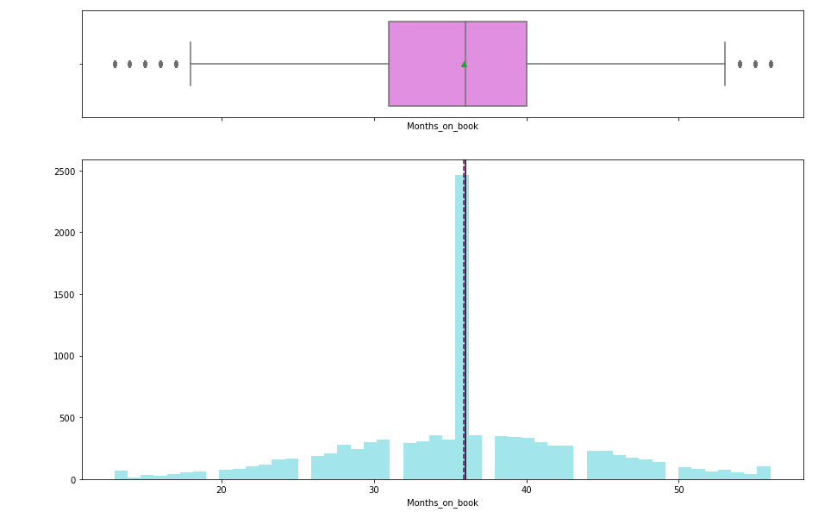
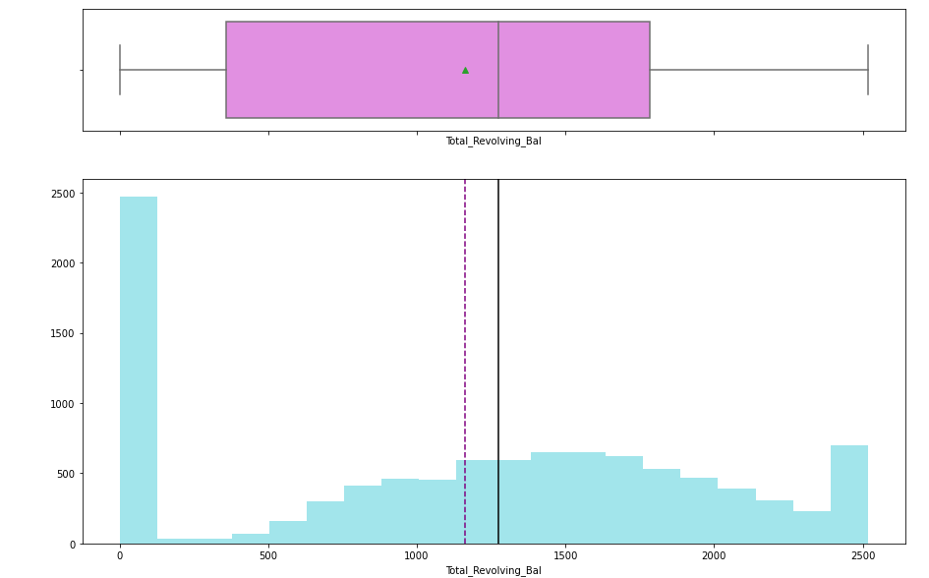
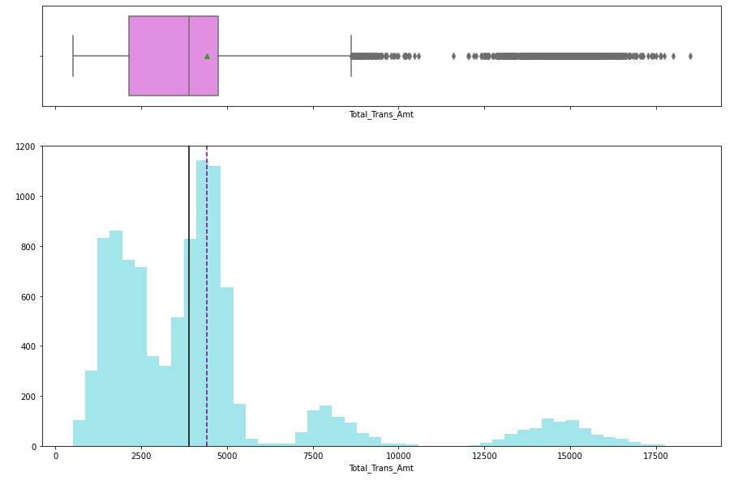
Exploratory Data Analysis-Months_on_book,Total_Revolving_Bal,Total_Tran_Amt
Months_on_book Total_Revolving_Bal Total_Tran_Amt
The mean and median value is same at 36
We can see some outliers where months < 15 and months > 50
Total_Revolving_Bal is left skewed
Most of the customers had a revolving balance of 0
The mean is at about 4500 for Total_Trans_Amt and we have outliers above 8500

Slide 7
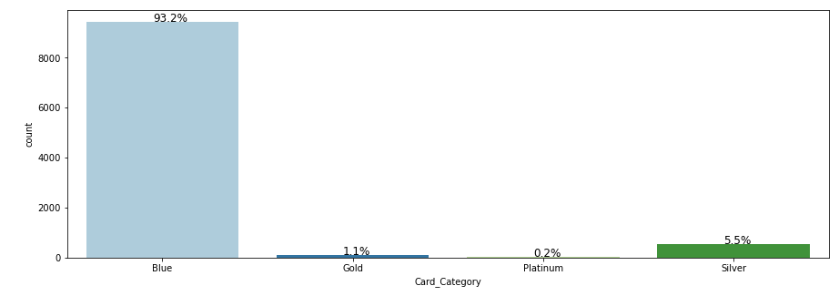
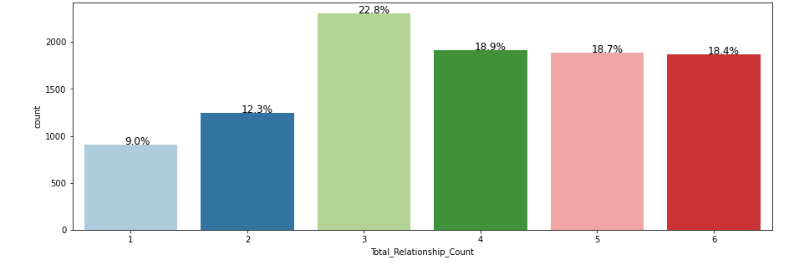
Exploratory Data Analysis-Income Category,Total Relationship_Count
35.2% percent customers make less than $40K,followed by 17.7% who make 40K-60K.
22.8% customers hold 3 products with the bank About 18% each hold 4 products and 5 and 6 products

Slide 8
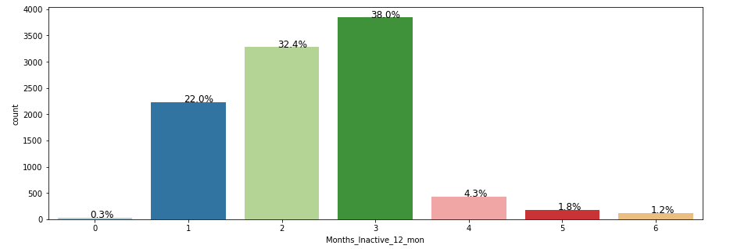
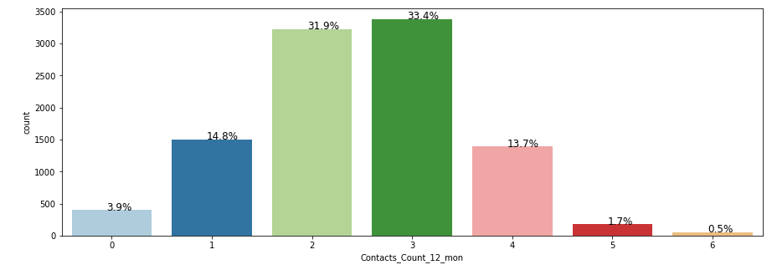
Exploratory Data Analysis-Months_Inactive_12_mon,Contacts_Count_12_month
38.0% customers had their card inactive for 3 months followed by 32.4% who had not used their card for 2 months.
1.2% have not used their card for 6 month
33.4% of the customers had contacted the bank or the bank has contacted the customer 3 times in the past 12 months & 31.9% we contacted 2 times

Slide 9
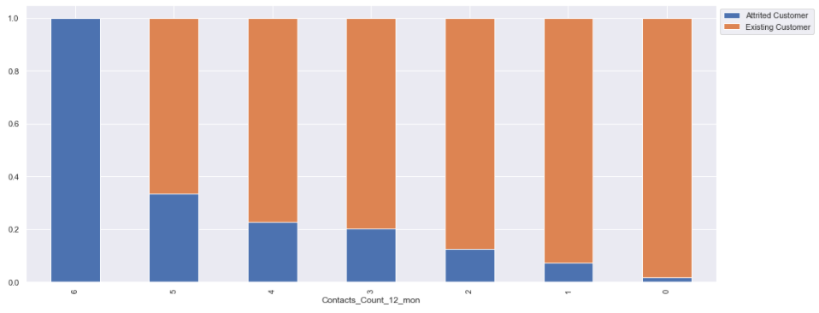
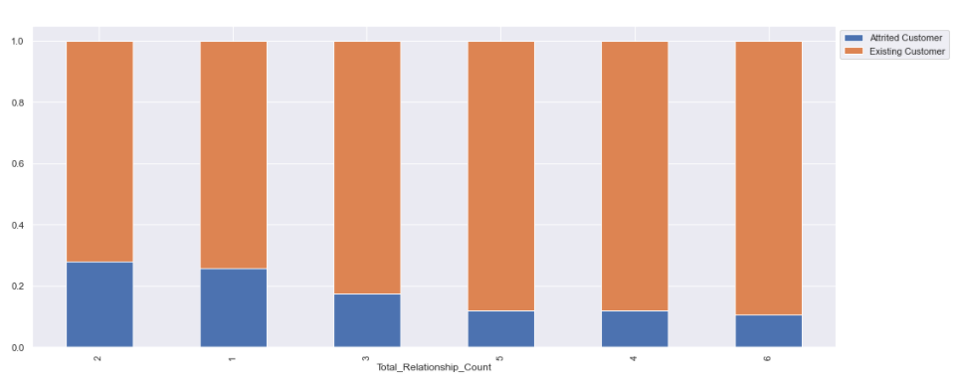
Exploratory Data Analysis with Attrition Flag & Contacts_Count_12_mon,Total_Relationship_Count
Attrition has been higher when there is higher number of contacts with the Bank in the last 12 months.
We can see that attrition is more for customers who hold 1 or 2 products compared to customers who hold more 4 or more products

Slide 10
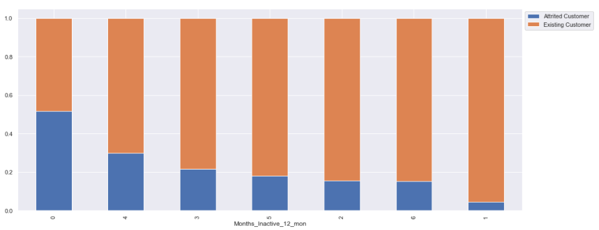
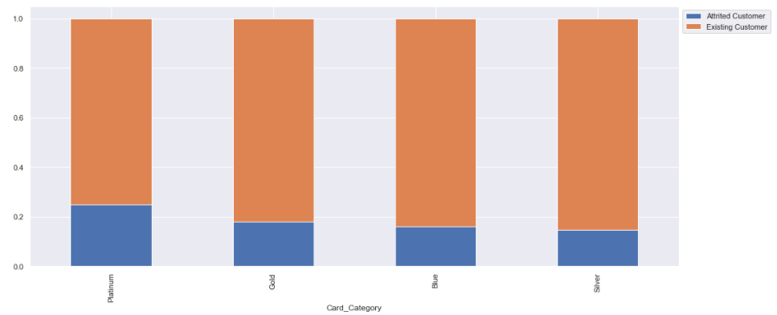
Exploratory Data Analysis with Attrition Flag & Months_Inactive_12_mon ,Card_Category
Interestingly customers who has not been inactive in the last 12 months are showing the highest attrition.
Customers who have been inactive for 3 or 4 months are also showing higher attritions
We can see that most of the attrited customers are using Platinum credit card
Customers using Gold,Blue,Silver cards have the same level of attrition

Slide 11
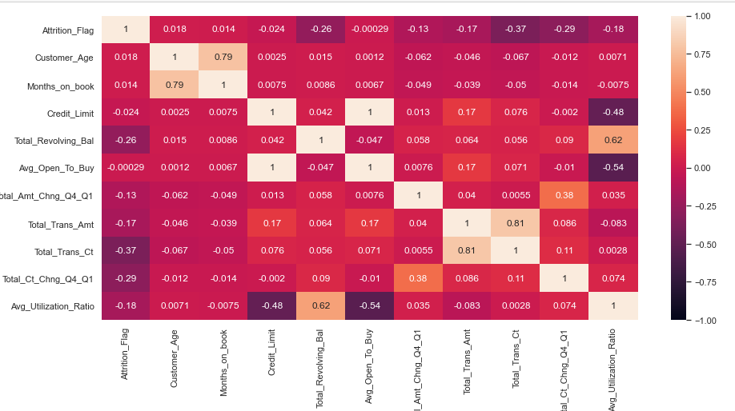
Exploratory Data Analysis-Correlation Heat Map
Attrition Flag has slight positive correlation with Customer Age,Dependent_count & Month_on_book.
Attrition Flag has slight negative correlation with
Total_Revolving_Bal,Total_Amt_Chng_Q4_Q1,
Total_Tran_Ct,Total_Ct_Chng_q4_q1 & Avg_Utilization_Ratio
There is strong positive correlation between
Customer_Age and Months_on_book which implies
that customers have long relationship with the bank
Total_Revolving_Bal has positive correlation with
Avg_Utilization_Ratio
Total_Tran_Amt & Total_Trans_Ct has positive correlation
Avg_Utilization_Ratio & Avg_Open_To_Buy has
negative correlation

Slide 12
Model Building Steps
Split the dataset into train and train sets
Impute missing values using KNNImputer
Choose Model performance evaluation metric
Build Model using Logistic Regression'
Oversample data using SMOTE
Perform Regularization on Model
Perform Under sampling using SMOTE
Build different models - DecisionTreeClassifier, RandomForestClassifier, BaggingClassifier,
AdaBoostClassifier, GradientBoostingClassifier, XGBClassifier
Tune hyperparameters of all models using GridSearchCV
Tune hyperparameters of all models using RandomizedSearchCV
Use pipelines in hyperparameter tuning
Compare all models’ performance on train and test data

Slide 13
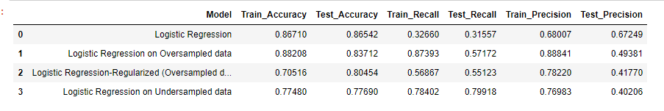
Comparing Model Performance-Logistic Regression
Logistic regression model on under sampled data has given a generalized performance with the highest recall on test data.

Slide 14
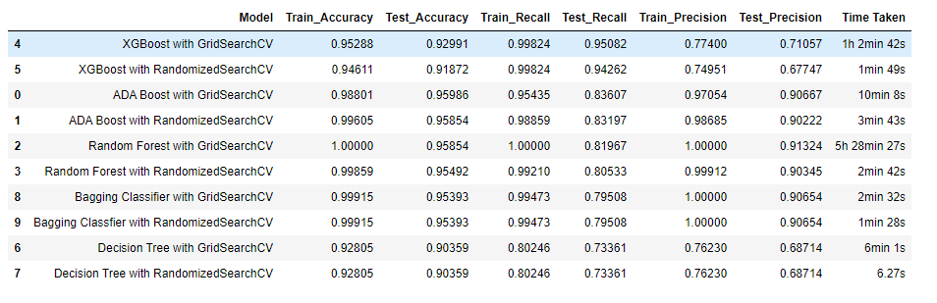
Comparing Model Performance Bagging and Boosting
The XGBoost model tuned using grid search is giving the best test recall of 0.95 and it has comparable Accuracy and Precision as well but based on the time taken XGBoost model with Randomized search is giving close performance with very good timing
Also we can see that the Random Forest with Grid Search has taken the highest time for completion with around 5 and half hours.The least amount of time has been taken by the Decision Tree model with Randomized Search with just 6.27 secs.

Slide 15
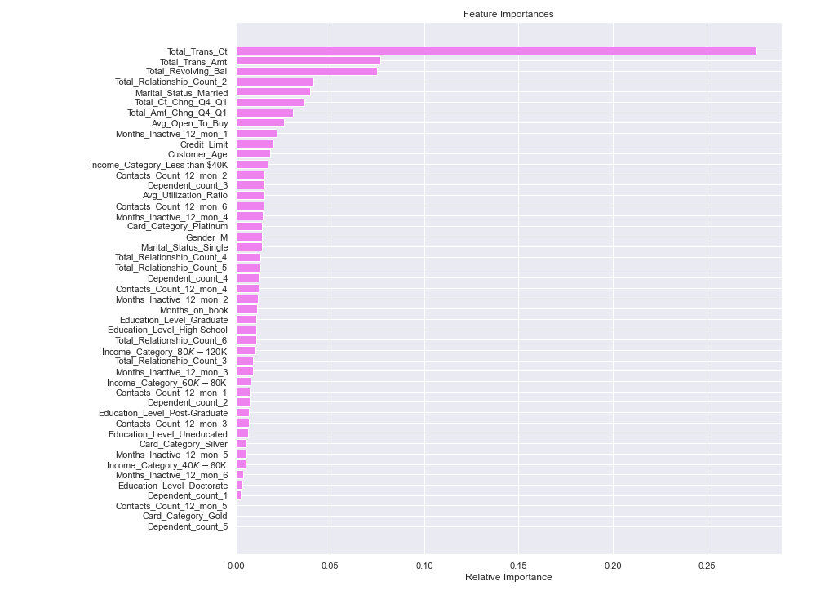
Feature Importance-XGBoost
Total_Tran_Ct is the most important
feature followed by Total_Trans_Amt
& Total_Revolving_Bal

Slide 16
Business Recommendations
The Bank should focus on customers who have less Total_Trans_Ct in the last 12 months as these are customers who have high chances of attriting.Obviously since these customers do not make much transactions they indicate that they do not use the credit cards much.Bank can provide some offers for these customers to get them using their credit cards
Similarly customers who have done less transaction in the past 12 months and those who have low revolving balance in their account have higher chances of attrition and the bank must focus on such customers and provide offers to retain them
Also customers who hold 2 products with the bank are the ones showing higher attrition.Bank can encourage such customers to get enrolled for more products which will help retain such customers
Change in transaction amount from Q4 over Q1 (Total_Amt_Chng_Q4_Q1) is less for attrited customers than existing customers.Customers have to encouraged to spend more.Offers can be provided.
Customers who have been inactive for a month show high chances of attrition.Bank should focus on such customers as well.
Other factors to focus are customers having income less than 40K, customers who have had high number of contacts with the bank in the last 12 months.

